Slide 1

College/ scholarship Information!
Posted on Denison Guidance Google Classroom!
Use class code: jzkcwls

Slide 2
Why College?
Colleges offer very practical, focused education where you are trained for a specific job.
They offer over 600 diploma, certificate and degree programs.

Slide 3
Careers!
Professional Golf Management- 100% job placement, paid co-op terms, free golf and lessons, can transfer to degree if you want etc. etc.
Ski Resort Operations
Music Industry Arts
Comedy Writing
Journalism
Radio and Television Broadcasting
Hospitality, Recreation and Leisure
E Business
911 and emergency response
Entertainment Administration (marketing and managing entertainers)

Slide 4
Where the jobs are…..
Ontario Colleges offer courses in THE TRADES:
With nearly half of the workforce eligible to retire in coming years, the demand for trades workers has never been higher. In the construction trades alone, over 200,000 jobs will need to be filled over the next decade by smart, skilled people.

Slide 5
Apprenticeships
Colleges offer the training for apprentices.
Weather you want to be an electrician, plumber , automotive technician, chef or hairstylist, colleges provide the in school segment.
You must find an employer to hire you while you are training.

Slide 6
Trades programs:
George Brown: Construction Trades - It exposes you to a variety of trades allowing you to determine which one interests you the most.
Durham College: Trade Fundamentals - see which one suits you best!
Carpentry
Electrical
Industrial maintenance
Machining
Plumbing
Welding
Heating, Ventilation and Air Conditioning (HVAC) essentials
Fleming College – Trade Fundamentals
Conestoga College (Waterloo) – Masonry, HVAC etc

Slide 7
Where the Jobs are!
Seneca is reporting some current “in demand” fields are:
IT and FINANCE – they don’t have enough students to fill co-op spots
Underwater Skills has one of the highest employment rate with average starting salaries from $62,000-$100,000+
Underwater skills programs combine diving training with construction and salvage techniques to prepare students for safe and effective work under the water, laying and repairing pipeline, inspecting underwater support structures and much more.
Durham reports: Fire and Life Safety Technician and Culinary Management are in need of Co-op students as well!

Slide 8
Why College?
Financially less expensive
$26 000 College vs $80 000 University (living away)
40% of admissions to college are University Graduates according to Seneca College

Slide 9
Cost of College Programs:
Average cost of tuition for one academic year in an Ontario college program:
Diploma Programs - $2,400
Graduate Certificate Programs - $3,600
Bachelor’s Degree Programs - $6,100
Collaborative Programs - $5,000
You can also expect an average of $800 in ancillary fees (student activity fees, athletic fees, health insurance, etc.) and $1,300 for books and supplies. Please note that these figures do not include living costs, such as rent, utilities and transportation.

Slide 10
Cost of College?
Tuition, books, fees and expenses = $4,500 x 3 years = $13 500
Living away- $4 000 - $6 000 x 3 years =$13000-$ 18 000
This means the average 3 year diploma =$26500 - $31 500

Slide 11



The Final Year….. No Regrets!
Are you stressed?
Not sure what to apply for?
Busy with studying, visiting schools, work and extracurricular activities?

Slide 12

Welcome Graduating class of 2020!

Slide 13




Some Thoughts:
Keep Organized!!
RESEARCH and plan visits!
Work hard – you could be 1% away from a scholarship or spot that you didn’t get. We don’t change marks after the fact! Earn them now.
Develop strong relationships with teachers and Guidance
If you need a teacher reference letter, give teachers lots of time to complete it!
Don’t leave things until the last minute ie. community hours, supplemental applications etc. etc.

Slide 14

Important Dates and Events!

Slide 15
Volunteer Fair – November 20 – café. Get this done!
Canadian Cancer Society
Habitat for Humanity
Newmarket Soccer Club
Town of Newmarket
SPCA
Neighborhood Network
Etc

Slide 16

How much will this cost and where do I get the money???

Slide 17
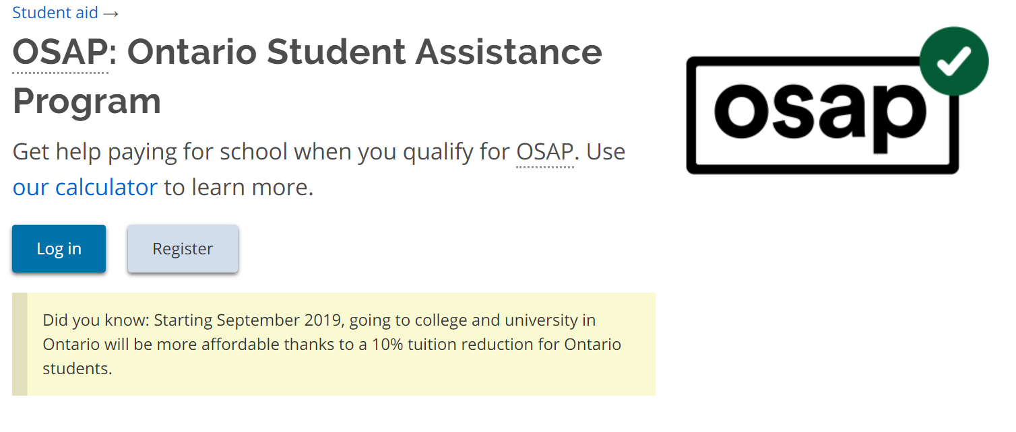

Slide 18
OSAP
There is no rush on applying for OSAP
Usually applied for in April – June as you have to tell them the school you have been accepted to.
You can apply later as well, but the funds may not be available when the tuition is due.
There is an OSAP Aid Estimator you can do now to see how much you may be eligible for!

Slide 19
Where to Look for Scholarships $$$
Pick up the list of websites in Guidance
Check the Scholarship Bulletin Board near Guidance
Research, research, research
Create a personal profile at www.studentawards.com or scholartree.ca – you will receive e-mails
Check other websites:
  www.canlearn.ca
  www.scholarshipscanada.ca
  www.osca.ca
  yconic.ca
  www.fundyourfuture.ca
  www.ontrasfer.ca
  www.servicescanada.gc.ca
  www.electronicinfo.ca (university)

Slide 20
Scholarship Research continued….
Fill out a scholarship form in Guidance to be considered for SCHOOL NOMINATED scholarships
Check the scholarship board located outside of the Guidance office and listen for announcements.
Attend the “Financing your education/OSAP” presentation on November 18th at 6:30pm in the Library at Denison.
Listen for announcements!

Slide 21
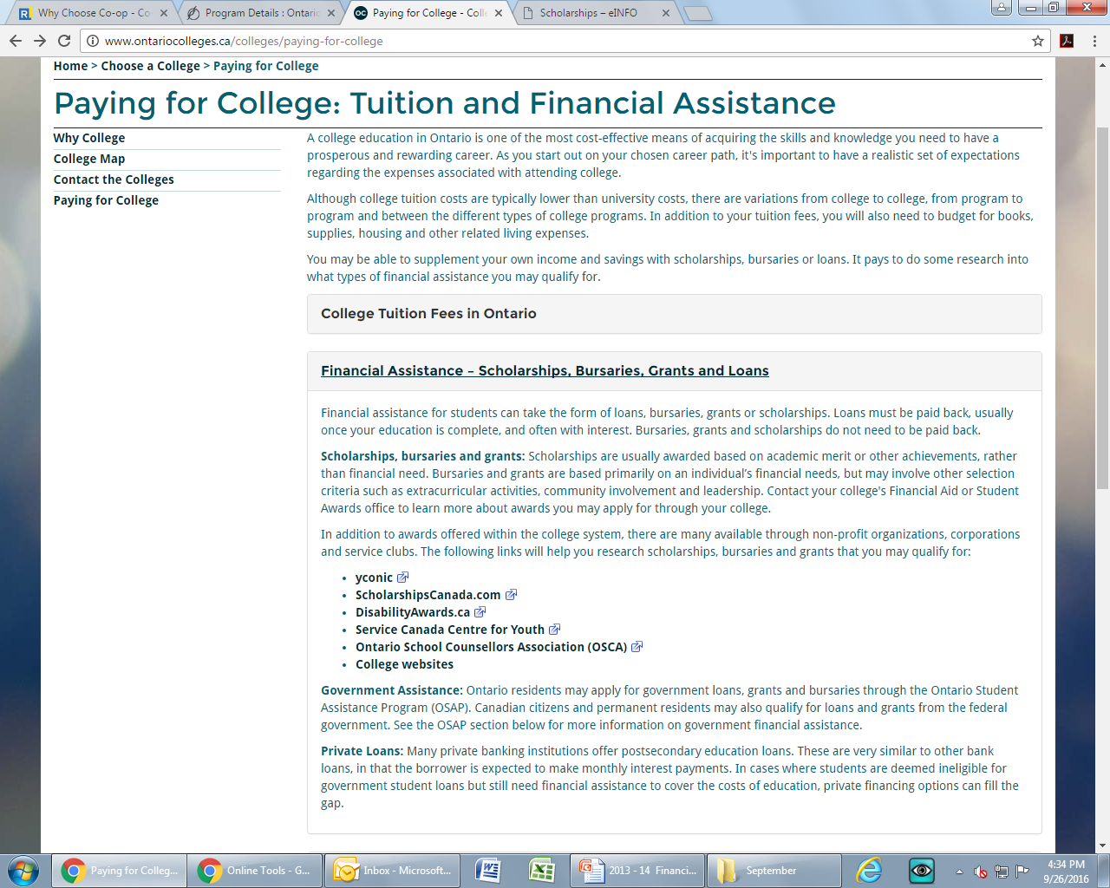
College Scholarships on Ontariocolleges.ca:

Slide 22


Slide 23
Application Details:
As of NOW…….October , you will have access to the college website to apply. You only need your OEN number. Once you have applied using the NEW USER section, your OCAS number will be generated.
Visit www.ontariocolleges.ca
NO PIN REQUIRED!

Slide 24
Timelines:
Early October 2020: Online Application Opens
In early October, access to the online college application becomes available for programs beginning in the following academic year (August to July). You may create an account and begin your application.
February 1, 2021: Equal Consideration Date
Apply on or before this date in order to receive equal consideration for admission to programs starting the following fall. After this date, colleges consider applicants on a first-come, first-served basis until programs are full.
Note that applications to Highly Competitive Programs must be received by this date in order to be considered. As these programs receive a high volume of applicants, all seats may be filled by February 1.

Slide 25
Timelines:
The following information will be sent to OCAS(Ontario College Application Center):
Your grade 9 - 12 final marks
Courses you are currently taking
Courses you will be taking in semester 2
Grade 12 semester 1 MID TERM marks will also be sent.

Slide 26
Note about courses and Marks!!!
28 out 0f 31 Ontario Colleges treat “C” level and “U” or “M” level courses equally!
If you are applying for a College Diploma program and mostly U or M level courses in a competitive program, you may want to come to Guidance and change some courses!
Durham Paramedic Program states “The intake average changes from intake to intake, however in recent years the intake average has been in the high 90s. This intake average is based off of the four prerequisite courses. These courses can be taken at the College, Mixed or University level. There is no advantage to taking University courses over College; we view them as the same. “

Slide 27
Cost of Applying
You may select 5 choices for $95
There is a maximum of 3 choices at any 1 college.
Whether you choose 1 or 5 choices, it is $95.

Slide 28
Start Your Research!
Use the College website - www.ontariocolleges.ca
Using the PROGRAM LOCATOR option:
You can search for a specific program or a specific occupation
You can access the College/University TRANSFER GUIDE.

Slide 29
Search Programs by ……
Interests
Sports
Music
Writing etc. etc. etc.

Slide 30
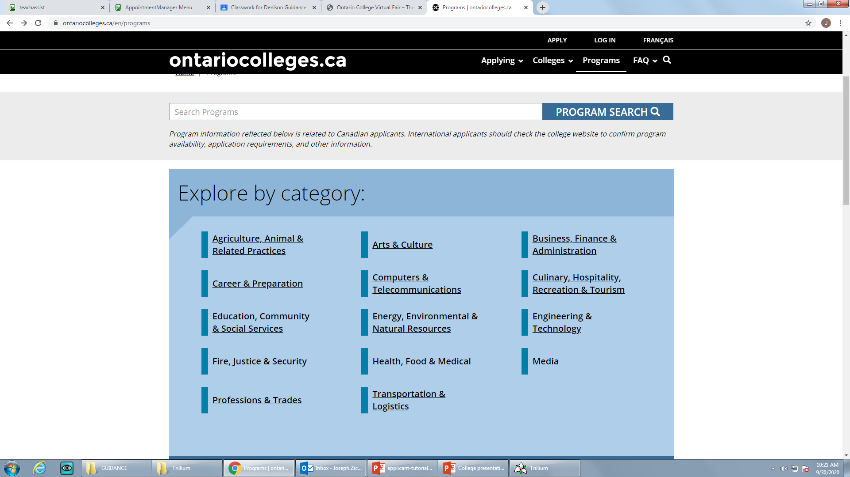

Slide 31
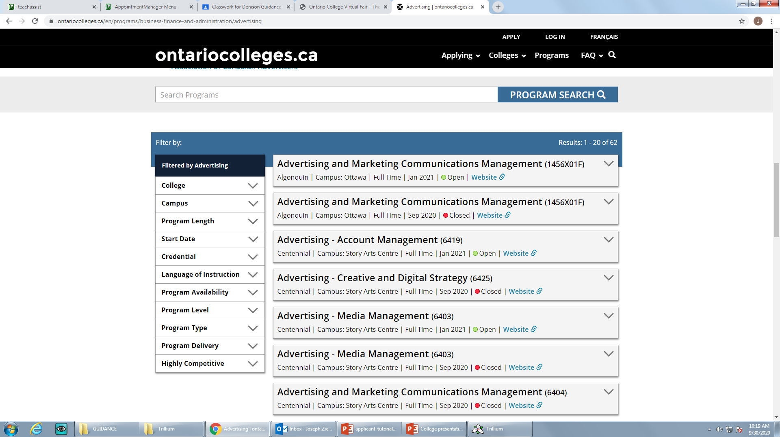

Slide 32
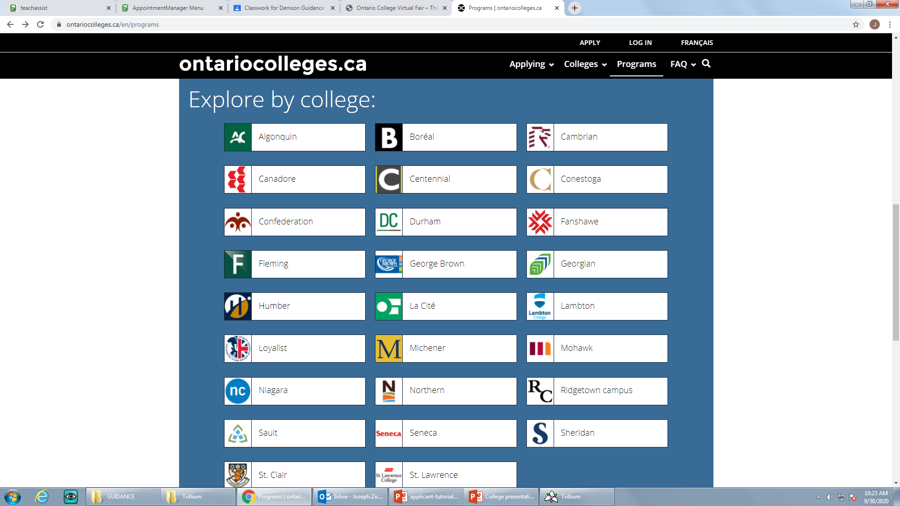

Slide 33
Final Thoughts…..
Research and Visit schools virtually!
CHECK YOUR EMAIL REGULARLY AND MEET ALL DEADLINES!
If you aren’t sure….make an appointment using Teach Assist for a Guidance Google Meet.

Slide 34

Work hard and good luck!

